Slide 1
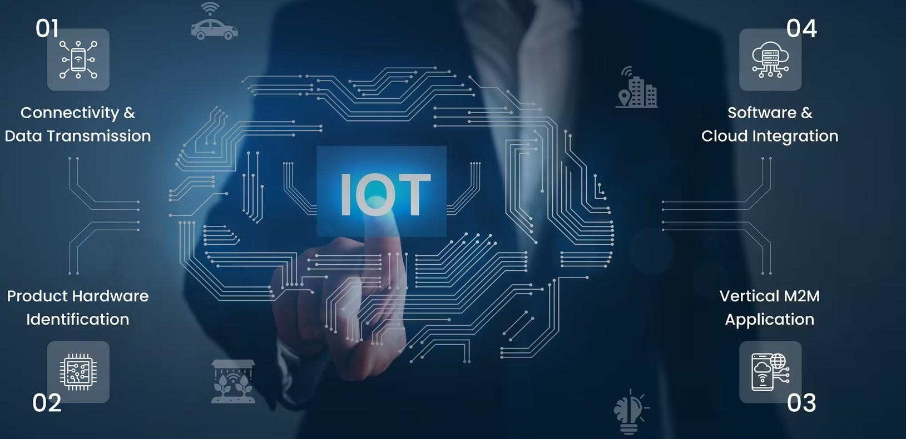
Serverless Iot Data Processing
Submitted by N.Ravichandran S.Naveen G.V.Ramanan A.Ragul
S.Meshach Immanual

Slide 2
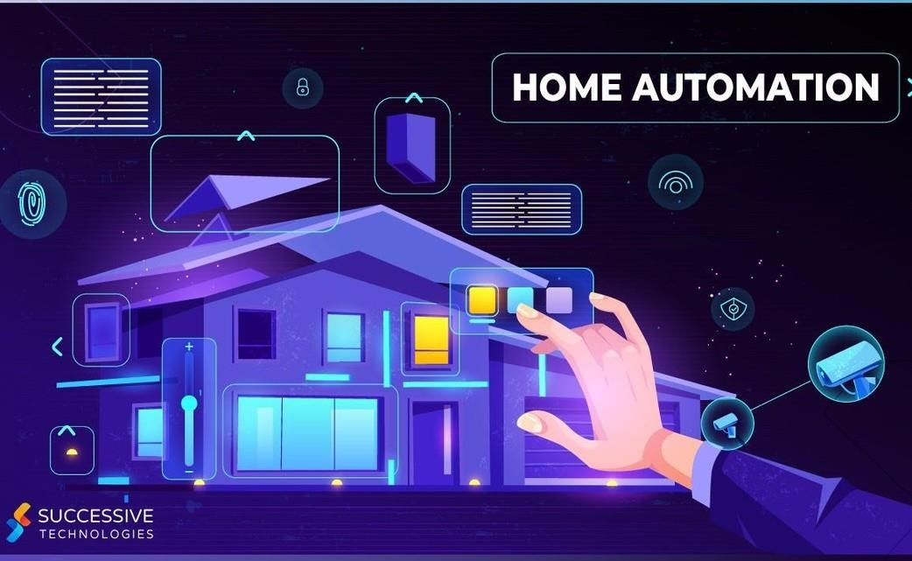
Problem Statement of Serverless Iot
Transforming your home into a smart living space using IBM Cloud Functions for IoT data processing.
Collect data from smart devices like thermostats, motion sensors, and cameras, and process it in real- time.
Automate routines for energy efficiency and home
security. Store and analyze data in IBM Cloud Object Storage to gain valuable insights into your smart home.

Slide 3
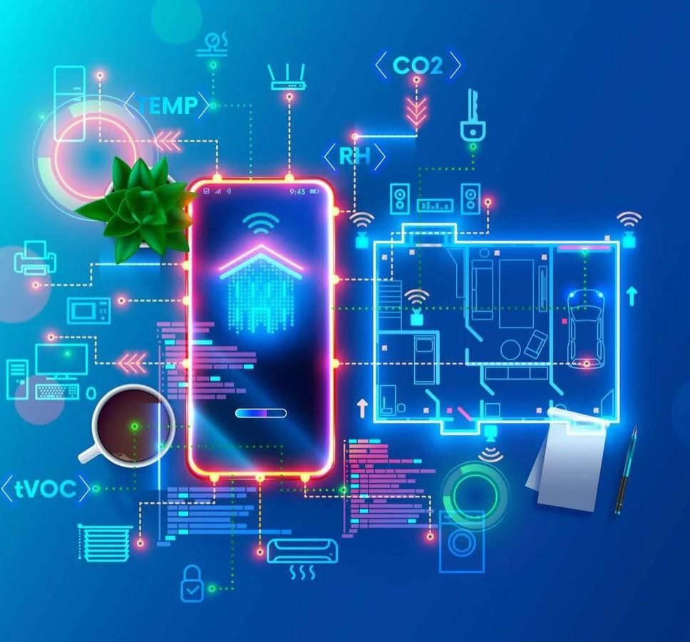
Problem and Design
The project is transform a normal home into a smart living space using IBM Cloud Functions for IoT data processing.
The goal is to collect data from various smart devices, process in real-time and automate routines for energy efficiency and home security.
It involves designing the smart home setup, implementing data collection and processing and leveraging IBM Cloud for storage and analysis.

Slide 4
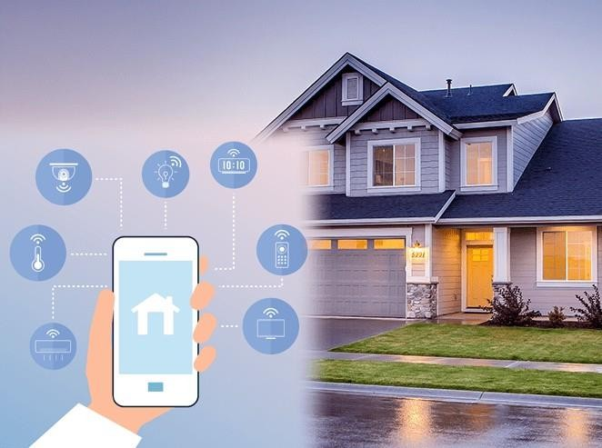
Design Thinking
Data Integration: Identify and integrate smart devices such as thermostats, motion sensors, and cameras into the smart home ecosystem.
Data Collection: Set up data collection from these devices, utilizing IoT protocols.
Real-time Processing: Implement real-time data processing using IBM Cloud Functions.
Automation: Develop automated routines for energy efficiency (e.g., adjustingthermostat settings) and home
security (e.g., sending alerts on motion detection) Storage and Analysis: Store data in IBM Cloud Object
Storage and analyze it to gain insights into energy consumption, security events, and patterns.

Slide 5
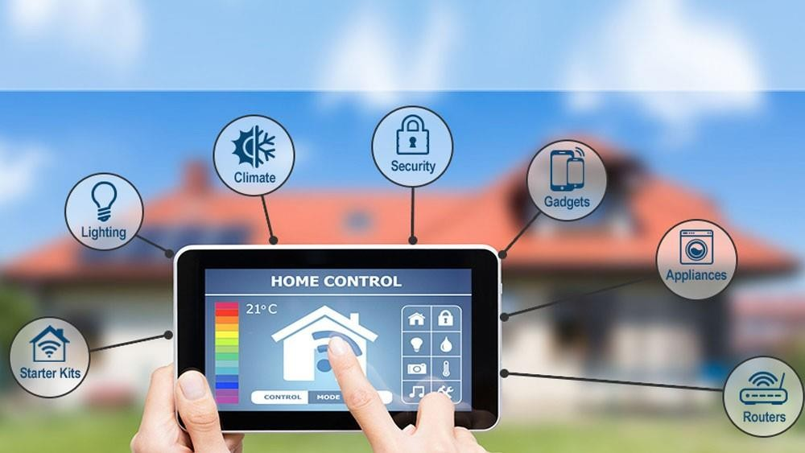
Idea for Iot
Automation
Consider integrating machine learning models to enhance the automation and decision making capabilities of the smart home.

Slide 6
Data Processing
Building the serverless IoT data processing solution using IBM Cloud Functions and device integration.

Slide 7
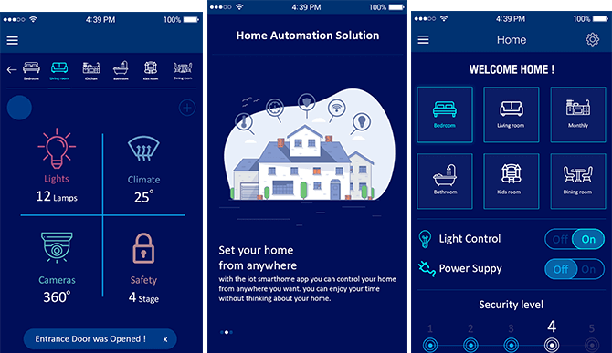
Implemenation
Continue build the solution by implementing real- time data processing, automation, and storage.

Slide 8
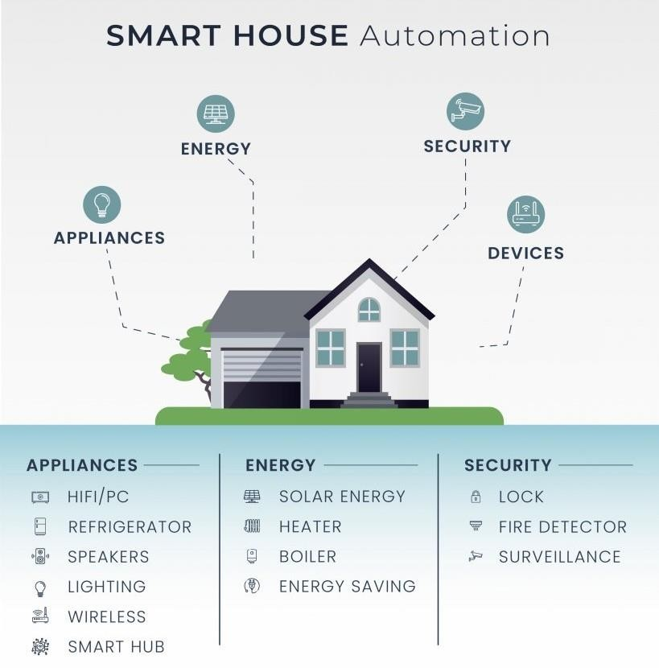
Benifits
Finally the Smart living space is created by using IBM cloud Function for build a Iot data processing
We can oprate the devices in outside of the home so its helps to reduce eletricity charge and some other issuse.

Slide 9
Thank You...

